Slide 1


RakshAI: Your Unyielding Shield
🔒 Empathy-Driven AI
📍 Real-time Geolocation
🛡️ Behavioral Intelligence
Powered by: PATH PREDICTORS – IILM UNIVERSITY
Innovation | Intelligence | Impact

Slide 2
PROJECT ARCHITECTS
PROJECT CONTRIBUTORS:
RUDRAKSH (2481025) – LEAD BACKEND DEVELOPER & AI ARCHITECT
AKSHIT SINGH (2481134) – FRONTEND DEVELOPER
ASHNA VATS (2481106) – DATA ENGINEERING & UI/UX SPECIALIST
SHIVANSEE (2481187) – FRONTEND DEVELOPER & RESEARCH
MENTORED BY:
DR. SAPNA ARORA (FACULTY MENTOR / PROJECT GUIDE)
SCHOOL OF COMPUTER SCIENCE & ENGINEERING
IILM UNIVERSITY, GURUGRAM
PROJECT ARCHITECTS
From Code to Care — Building Safety Into Every Signal

Slide 3
TABLE OF CONTENT
PROBLEM STATEMENT
EXISTING SOLUTIONS
FRAMEWORK OF PROPOSED SOLUTION
PROPOSED APPROACH
SAFETY WORKFLOW
CORE TECHNOLOGIES
REFERENCES

Slide 4

PROBLEM STATEMENT
Increasing concerns related to personal safety and unwanted attention in public areas contribute to a heightened sense of caution and limit individuals’ freedom of movement.
Current safety applications like Raksha, Himmat, and bSafe primarily depend on manual activation, making them less effective in urgent or incapacitating situations.
Response efforts are often delayed due to imprecise location tracking and difficulties in verifying the authenticity of alerts.
There is a noticeable gap in real-time, AI-enabled proactive safety solutions, particularly in densely populated Tier-1 cities where rapid response is critical.

Slide 5
EXISTING SOLUTIONS
Emergency Helplines – Emergency helplines rely on the user’s ability to initiate a call, which may not be feasible during high-stress or incapacitating situations.
Mobile SOS Buttons – Mobile SOS features can initiate alerts, but their effectiveness is limited as they still require deliberate user activation during emergencies.
Limitations of Existing Safety Apps (e.g., Raksha, Himmat, bSafe):
While these platforms provide location sharing and emergency alert features, they face key challenges:
3.1. Dependence on manual activation reduces effectiveness in critical moments.
3.2. Delays in response due to coordination and tracking inefficiencies.
3.3. Alert verification challenges can lead to false positives or overlooked genuine threats.
Our Vision - AI that cares, reacts, and protects. “Because safety shouldn’t be a privilege—it’s a right.”

Slide 6
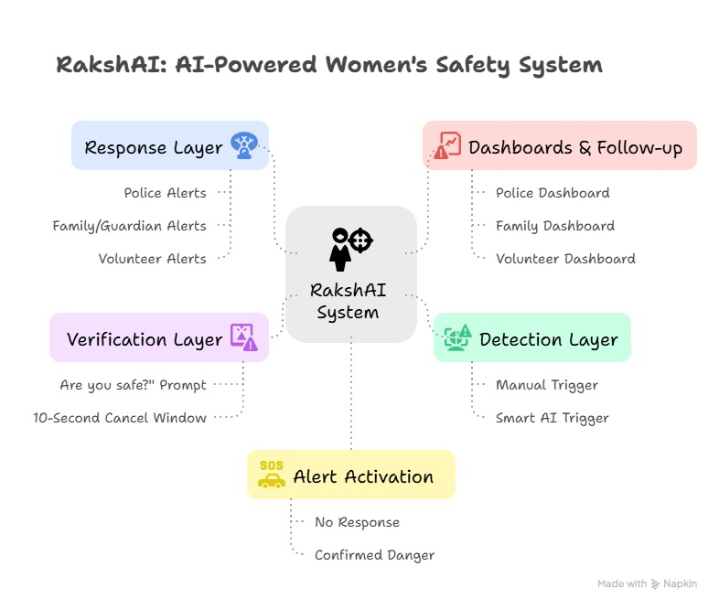
RakshAI Framework: Proposed Approach

Slide 7
RakshAI in Action
RakshAI – Your Intelligent Safety Companion
“Built with empathy. Powered by AI. Driven by safety.”
What is RakshAI?
An AI-driven safety web application designed to proactively and reactively safeguard women in public spaces using:
AI & behavioral analytics
Real-time motion & GPS data
Rapid emergency response integration
How It Works
Monitors behavioral anomalies: ✔ Sudden shakes ✔ Unexpected stops ✔ Rapid direction changes ✔ Prolonged inactivity in unfamiliar zones
Uses lightweight on-device ML models for real-time detection
Key Features
✔ Touch-to-Cancel (10s window) to avoid false alarms ✔ Minimal-interface emergency mode for instant SOS ✔ Predictive Safety Layer:
Crime-prone zone visualization
Safer route suggestions
Multi-Layered Alert Protocol
Captures voice clip & optional snapshot (with consent)
Shares live geolocation with: ✔ Local response units ✔ Guardians ✔ Emergency contacts
Displays nearby safety zones + turn-by-turn navigation
RakshAI isn’t just an app—it’s an intelligent guardian.

Slide 8
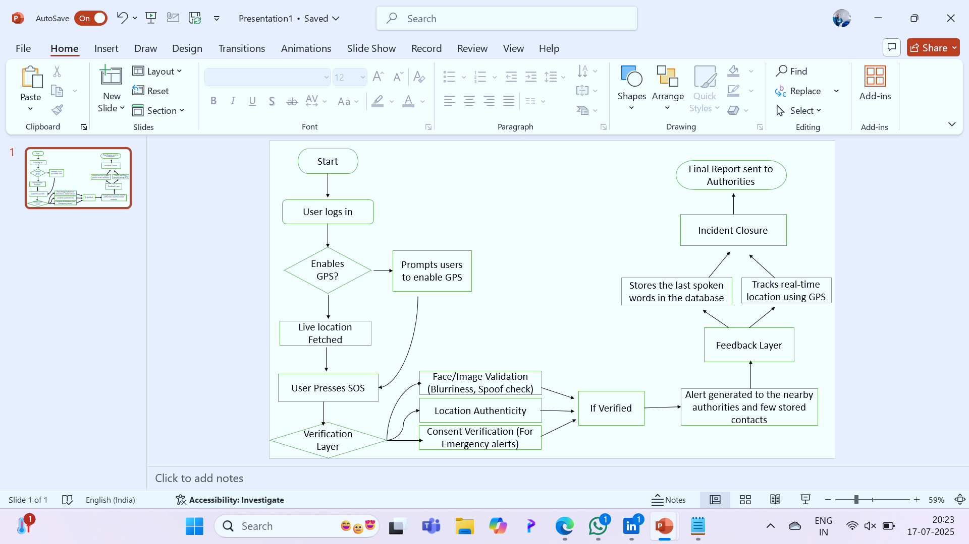
RakshAI: Smart Safety Workflow

Slide 9




RakshAI – Core Technologies
Frontend / UI
HTML5, CSS3, JavaScript
Bootstrap / Tailwind CSS – responsive design
React.js or Vanilla JS – interactive elements
APIs / SDKs
Google Maps API – live location tracking & safe zone mapping
MediaPipe / TensorFlow Lite – on-device behavioral analysis (planned)
Twilio or Firebase Cloud Messaging – alerts & notifications
Backend
Python (Django Framework)
Django REST Framework – secure APIs
Version Control & Deployment
GitHub – codebase management
Render / Heroku / Vercel – quick deployment
Database
SQLite – development & prototype phase
PostgreSQL – production-level scalability
Optional (Future Enhancements)
Flutter / React Native – full mobile app deployment
Firebase – authentication & real-time database

Slide 10
REFERENCES
Pawar, S. S., Roy, R., Sawant, K. V., Singh, R. B., & Navale, M. (2025). RescueNow: Real‑time SOS and predictive women’s safety system. International Journal for Research in Applied Science and Engineering Technology. https://doi.org/10.22214/ijraset.2025.70070
Sarma, P., Ahmed, D., & Bezbaruah, P. (2023). Android-based women safety app. Indian Journal of Science and Technology, 16(Special Issue 2), 60–69. https://doi.org/10.17485/IJST/v16iSP2.8767
Goradiya, U., Pandey, N., Khan, M. A., Tiwari, S., & Pawar, M. B. (2024). SAKHII–Empowering women with one‑tap safety app. International Journal of Scientific Research in Computer Science, Engineering and Information Technology. https://doi.org/10.32628/CSEIT2410254
More, R., Patil, S., Talekar, S., & Nikam, S. (2022). Women safety with auto voice detector. Ijraset Journal for Research in Applied Science and Engineering Technology. https://doi.org/10.22214/ijraset.2022.47216

